Slide 1
AI FOR BUSINESS, SOCIETY, and GLOBAL AFFAIRS
The World Affairs Council of Greater Houston:
The Global Exchange
Notes:
Welcome. Today’s briefing is about the collision between AI, data centers, and national security. As AI grows, it’s demanding massive energy resources—and we need to understand how that shapes strategic power in both the U.S. and abroad.

Slide 2
Brad GROUX
Experience
CEO of Digital Meld
Senior Solutions Architect at Unqork
Senior Solutions Architect at JMT
Senior Manager at Macquarie
Senior Systems Engineer at Quantlab
Premier Field Engineer at Microsoft
Principal Solution Architect of AI, Data, Software, and Services at the Global Scale
SOLUTIONS ARCHITECT
CEO
Capabilities
Solutions Architecture
90%
Data Architecture
80%
About Me
Founder and CEO at Digital Meld with extensive experience in cloud-based AI, solution architecture, and business process automation. Skilled in designing innovative, scalable solutions leveraging Azure, Microsoft Power Platform, and open-source large language models. Deep expertise in systems architecture, enterprise integrations, DevOps, and data analytics across diverse industries.
AI & Machine Learning
80%
Data Visualization
90%
DevOps
90%
Cloud Solutions
80%

Slide 3
ARTIFICIAL INTELLIGENCE has three key components
The growth and adoption of AI isn’t just technology, it is mostly an infrastructure problem.
DATA CENTERS
Energy
CODE / TRAINING
GPU intensive data centers require more power, and water for cooling.
AI requires unprecedented usage and delivery via transmission lines.
Rapid AI development accelerates exponentially due to AI tools.
Notes:
AI growth is a three-pronged problem. We require data centers, energy, and development.

Slide 4
THE EVOLUTION
of AI
Decades of research and investment have gone into AI since its conception in the mid-20th century
Despite this, the field has historically been plagued by a pattern of lofty promises that often fall short
We are finally witnessing the realization of AI’s long-promised potential
Notes:
AI has been in development and under research for more than 80 years, and during that time most investment didn’t bear fruit. That trend has changed dramatically.

Slide 5
WE’ve Been Here before
THE INTERNET
1995
1996
1997
1998
1999
Netscape
First major awareness of the internet
First major internet-related investment
Most companies have internet-related budgets
Most internet budgets double or triple in size
ARTIFICIAL INTELLIGENCE
2022
2023
2024
2025
2026(?)
ChatGPT Launches
First major awareness of AI
First major AI-related investment
Most companies have AI-related budgets
Most AI budgets double or triple in size?
Notes:
The rise of AI aligns almost in sync with the rise of the internet.

Slide 6
AI TERMINOLOGY
Artificial Intelligence (AI) refers to systems with the ability to learn and reason like humans.
ARTIFICIAL INTELLIGENCE

Slide 7
ARTIFICIAL INTELLIGENCE
AI TERMINOLOGY
Planning & Scheduling
Natural Language Processing
Knowledge Representation
Speech Recognition
Artificial Intelligence (AI) refers to systems with the ability to learn and reason like humans.
Computer Vision
Fuzzy Logic
Expert Systems
Auto Reasoning
AI Ethics
Robotics
These systems can perform tasks that typically require human intelligence, such as visual perception, speech recognition, decision-making, and language translation.

Slide 8
ARTIFICIAL INTELLIGENCE
AI TERMINOLOGY
Planning & Scheduling
Natural Language Processing
Knowledge Representation
Speech Recognition
Machine Learning is a branch of artificial intelligence that focuses on building systems that can learn from and make decisions based on data.
Computer Vision
Fuzzy Logic
Expert Systems
Auto Reasoning
AI Ethics
Robotics
MACHINE LEARNING

Slide 9
ARTIFICIAL INTELLIGENCE
AI TERMINOLOGY
Planning & Scheduling
Natural Language Processing
Knowledge Representation
Speech Recognition
Machine Learning is a branch of artificial intelligence that focuses on building systems that can learn from and make decisions based on data.
Computer Vision
Fuzzy Logic
Expert Systems
MACHINE LEARNING
Auto Reasoning
AI Ethics
Decision Trees
Classification
Regression
Robotics
Reinforcement Learning
Support Vector Machines
Clustering
Naïve Bayes
Unlike traditional software programming, where tasks are explicitly coded, machine learning allows systems to adapt and improve from experience.
This is achieved through algorithms that iteratively learn from data, adjusting and refining their models to predict outcomes more accurately over time.

Slide 10
ARTIFICIAL INTELLIGENCE
AI TERMINOLOGY
Planning & Scheduling
Natural Language Processing
Knowledge Representation
Speech Recognition
Deep Learning is a type of machine learning that uses neural networks with many layers, a concept inspired by the brain’s structure and function.
Computer Vision
Fuzzy Logic
Expert Systems
MACHINE LEARNING
Auto Reasoning
AI Ethics
Decision Trees
Classification
Regression
Robotics
Reinforcement Learning
Support Vector Machines
Clustering
Naïve Bayes
DEEP LEARNING

Slide 11
ARTIFICIAL INTELLIGENCE
AI TERMINOLOGY
Planning & Scheduling
Natural Language Processing
Knowledge Representation
Speech Recognition
Deep Learning is a type of machine learning that uses neural networks with many layers, a concept inspired by the brain’s structure and function.
Computer Vision
Fuzzy Logic
Expert Systems
MACHINE LEARNING
Auto Reasoning
AI Ethics
Decision Trees
Classification
Regression
Robotics
Reinforcement Learning
Support Vector Machines
Clustering
Naïve Bayes
DEEP LEARNING
CNNs
Back Propagation
RNNs
Deep Learning is currently the dominant approach to building AI systems.
This is because of its incredible ability to handle vast amounts of data and discover intricate patterns that are not readily apparent to humans or other traditional computational methods.
Transformers
Dropout
Transfer Learning
Activation Functions
Autoencoders

Slide 12
ARTIFICIAL INTELLIGENCE
AI TERMINOLOGY
Planning & Scheduling
Natural Language Processing
Knowledge Representation
Speech Recognition
Generative AI refers to a category of artificial intelligence algorithms capable of generating new content.
Computer Vision
Fuzzy Logic
Expert Systems
MACHINE LEARNING
Auto Reasoning
AI Ethics
Decision Trees
Classification
Regression
Robotics
Reinforcement Learning
Support Vector Machines
Clustering
Naïve Bayes
DEEP LEARNING
CNNs
Back Propagation
RNNs
Transformers
Dropout
Transfer Learning
Activation Functions
Autoencoders
GENERATIVE AI

Slide 13
ARTIFICIAL INTELLIGENCE
AI TERMINOLOGY
Planning & Scheduling
Natural Language Processing
Knowledge Representation
Speech Recognition
Generative AI refers to a category of artificial intelligence algorithms capable of generating new content.
Computer Vision
Fuzzy Logic
Expert Systems
MACHINE LEARNING
Auto Reasoning
AI Ethics
Decision Trees
Classification
Regression
Robotics
Reinforcement Learning
Support Vector Machines
Clustering
Naïve Bayes
DEEP LEARNING
This content can take various forms, such as text, images, audio, video, and more.
Unlike traditional AI, which typically focuses on recognizing patterns and making predictions based upon existing data, generative AI creates new data that resembles the data on which it was trained.
CNNs
Back Propagation
RNNs
Transformers
Dropout
Transfer Learning
Activation Functions
Autoencoders
GENERATIVE AI
Language
Modeling
Variational Autoencoders
Diffusion
Summarization
Text Generation
Video Generation
Natural Language Understanding

Slide 14
ARTIFICIAL INTELLIGENCE
AI TERMINOLOGY
Planning & Scheduling
Natural Language Processing
Knowledge Representation
Speech Recognition
IN SUMMARY
Computer Vision
Fuzzy Logic
Expert Systems
MACHINE LEARNING
Auto Reasoning
AI is an umbrella term.
Machine Learning (ML) is a subset of AI, meaning all machine learning is a type of AI.
However, not all AI relies on Machine Learning; there are other approaches to creating AI beyond Machine Learning.
Deep Learning, a specific approach within machine learning, is currently the leading method used to build advanced AI systems.
AI Ethics
Decision Trees
Classification
Regression
Robotics
Reinforcement Learning
Support Vector Machines
Clustering
Naïve Bayes
DEEP LEARNING
CNNs
Back Propagation
RNNs
Transformers
Dropout
Transfer Learning
Activation Functions
Autoencoders
GENERATIVE AI
Language
Modeling
Variational Autoencoders
Diffusion
Summarization
Text Generation
Video Generation
Natural Language Understanding

Slide 15
AI TERMINOLOGY
ARTIFICIAL GENERAL INTELLIGENCE (AGI)
ARTIFICIAL SUPER INTELLIGENCE (ASI)
AGI is a type of AI with the ability to understand, learn, and apply knowledge across a wide range of tasks, at or beyond human-level capability.
Performs any cognitive task a human can
Learns and adapts across domains
Exhibits reasoning, abstraction, and common sense
Capable of self-improvement and transfer learning
ASI is a theoretical form of AI that vastly exceeds human intelligence in all areas, scientific reasoning, creativity, social skills, and strategic thinking.
Surpasses the best human minds in every field
Capable of self-enhancement and recursive improvement
May lead to rapid, unpredictable societal transformation
Central to debates on AI alignment and safety
Notes:
Think of AGI as an AI that doesn't just specialize—it generalizes like a human.
ASI is not just smart—it’s superintelligent, and its decisions may be beyond our comprehension.

Slide 16
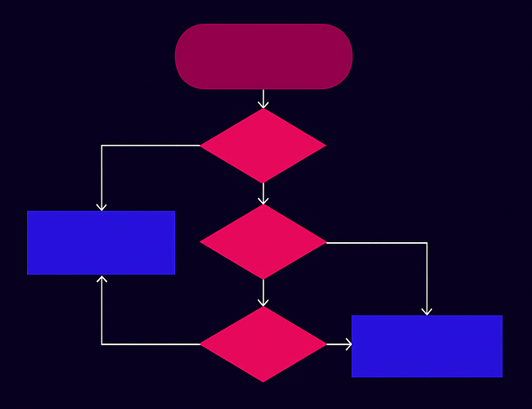
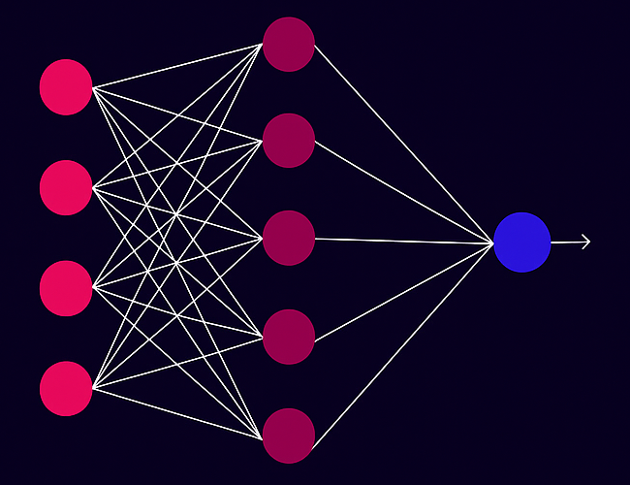
TWO PATHS TO INTELLIGENCE
SYMBOLIC AI
CONNECTIONIST AI
Dominant from the 1950s to 1990s - emphasized logic, reasoning, and explicit rule-based modeling.
Rooted in cybernetics and neural networks, treats intelligence as emergent from distributed, adaptive computation.
Notes:
Symbolic AI (dominant from the 1950s to 1990s) emphasized logic, reasoning, and explicit rule-based modeling.
Connectionist AI, rooted in cybernetics and neural networks, treats intelligence as emergent from distributed, adaptive computation.

Slide 17
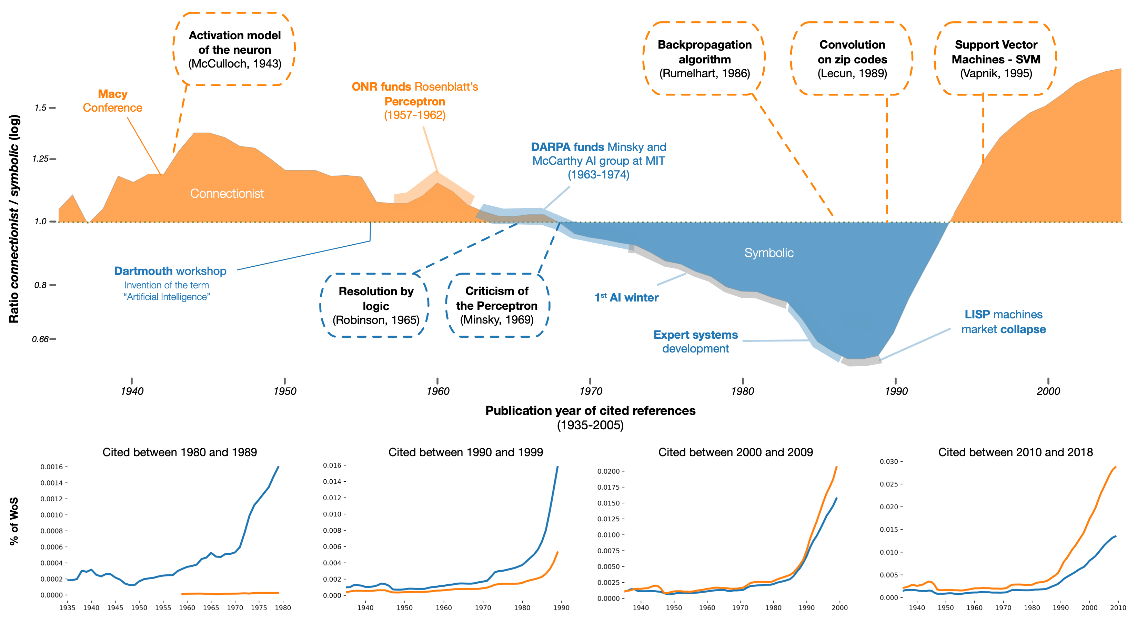
AI Timeline
Source: Neurons Spike Back
Evolution of the academic influence of connectionist and symbolic approaches to AI
Notes:
The symbolic school, established by figures like McCarthy and Minsky, largely marginalized neural networks during the “AI winters.”
The Revival of Neural Networks - Starting in 2010, deep learning began outperforming traditional AI in tasks like image recognition and speech processing.

Slide 18
NEURAL NETWORKS EXPLAINED
Source: 3blue1brown
A neural network is a layered system of interconnected nodes (“neurons”) that learns to recognize patterns in data.
Inspired by the brain, it processes inputs (like images or text) and outputs predictions through a network of weighted connections.
Input Layer: Takes raw data (pixels, numbers, etc.)
Hidden Layers: Apply transformations using weights, biases, and activation functions.
Output Layer: Produces a final prediction or classification.
The network learns by adjusting weights using backpropagation to minimize error (loss), improving its predictions over time.
Notes:
Think of neurons as buckets of data.

Slide 19
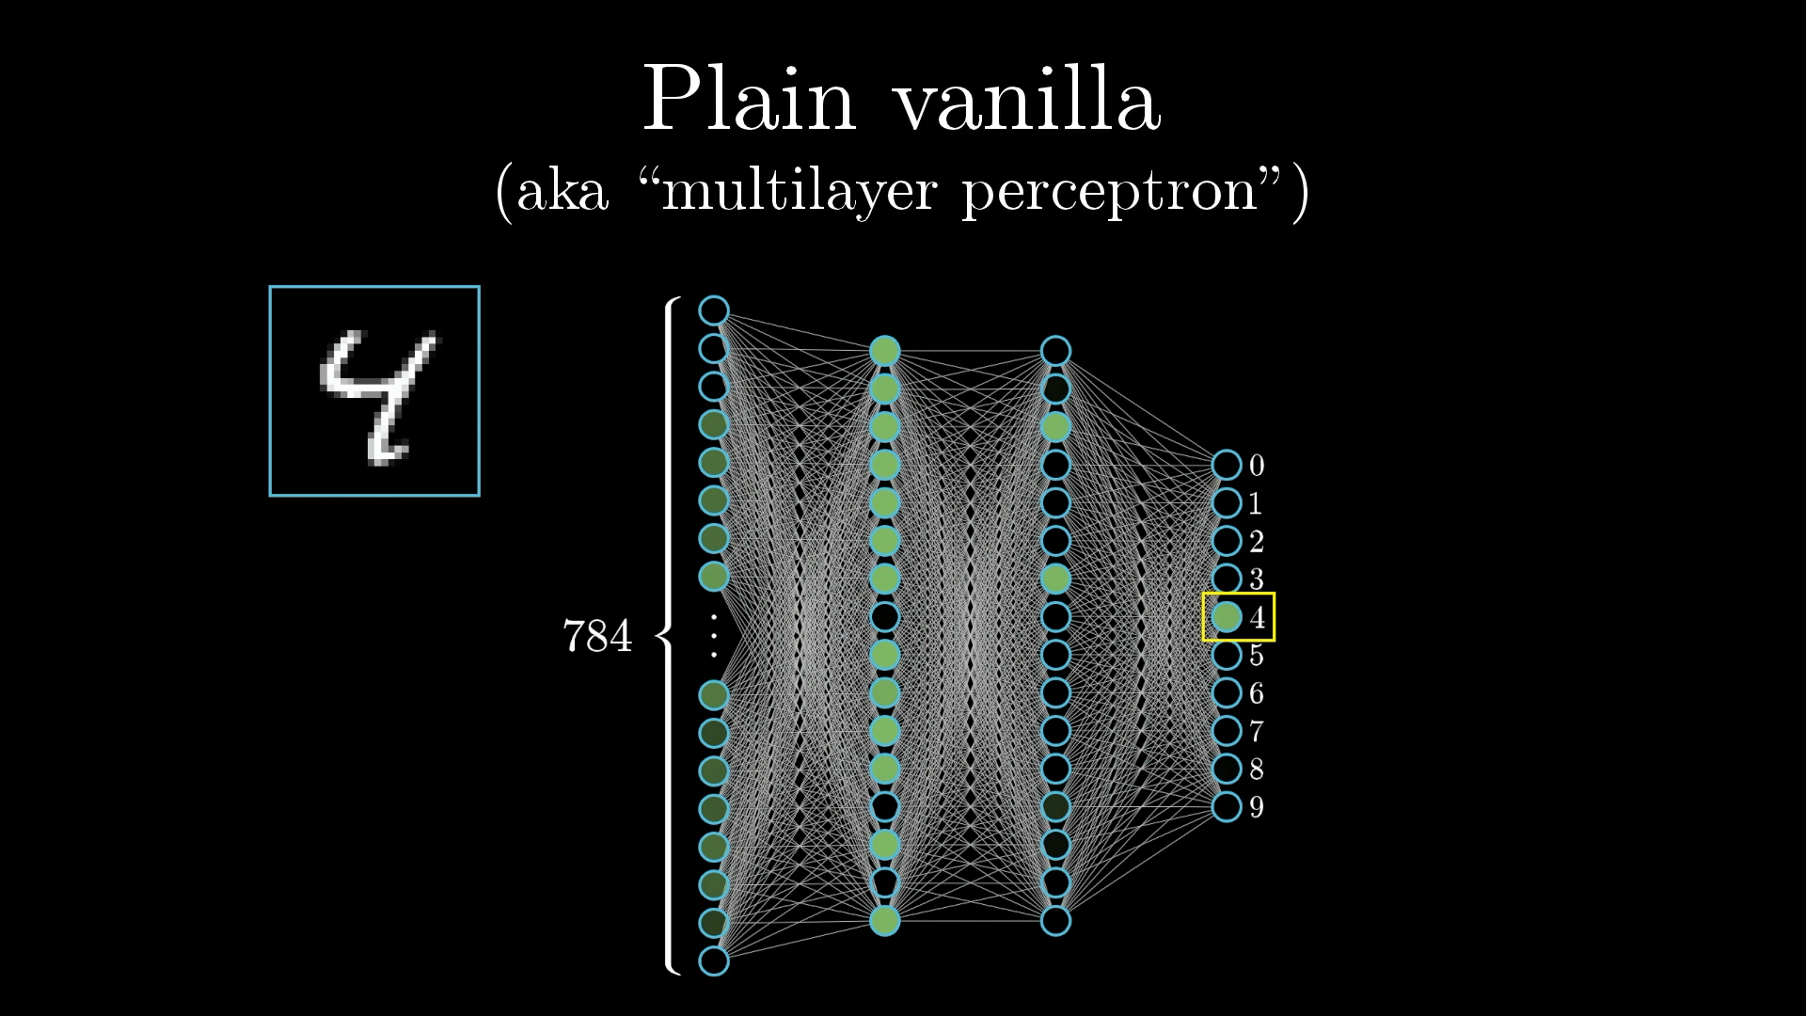
NEURAL NETWORKS EXPLAINED
Source: 3blue1brown
The simple network we’re using to identify digits is just a few layers of neurons linked together.
Notes:
Symbolic AI (dominant from the 1950s to 1990s) emphasized logic, reasoning, and explicit rule-based modeling.
Connectionist AI, rooted in cybernetics and neural networks, treats intelligence as emergent from distributed, adaptive computation.

Slide 20
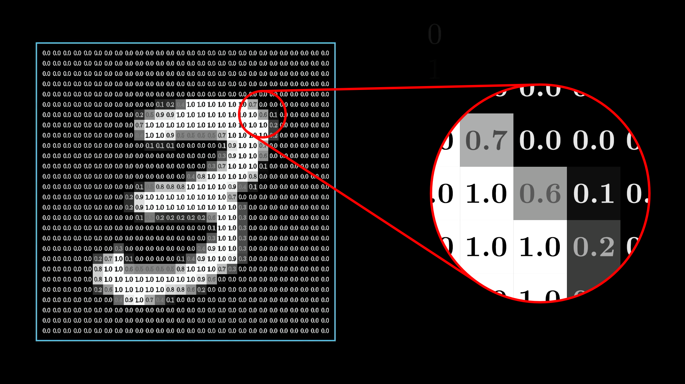
NEURAL NETWORKS EXPLAINED
Source: 3blue1brown
The input layer contains 784 neurons, each of which corresponds to a single pixel in the original image.
Notes:
Symbolic AI (dominant from the 1950s to 1990s) emphasized logic, reasoning, and explicit rule-based modeling.
Connectionist AI, rooted in cybernetics and neural networks, treats intelligence as emergent from distributed, adaptive computation.

Slide 21
NEURAL NETWORKS EXPLAINED
Source: 3blue1brown
Watching the activations in each layer propagate through to determine the activations in the next can be quite mesmerizing.
Notes:
Symbolic AI (dominant from the 1950s to 1990s) emphasized logic, reasoning, and explicit rule-based modeling.
Connectionist AI, rooted in cybernetics and neural networks, treats intelligence as emergent from distributed, adaptive computation.

Slide 22
Agentic AI refers to AI systems that can autonomously perceive, reason, plan, and act to achieve goals with minimal human intervention.

Slide 23
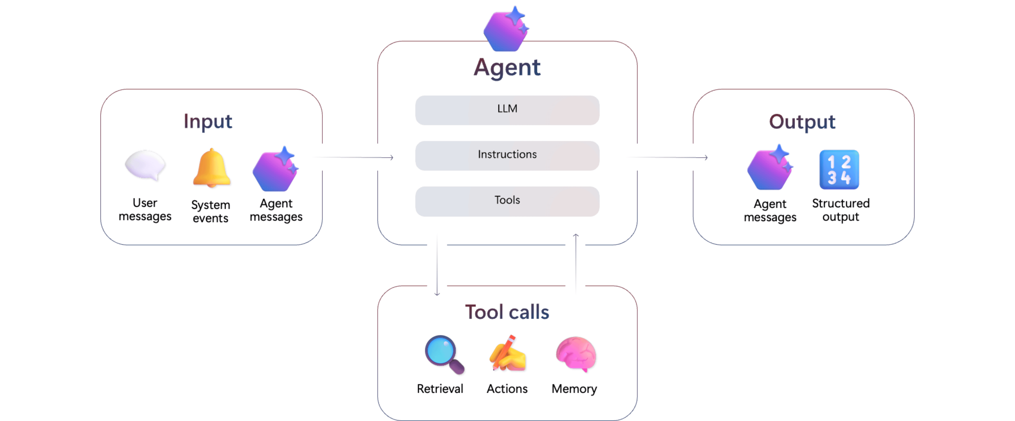
Agentic ai
Agentic AI is like a smart assistant that can not only follow instructions but also figure out what needs to be done, make decisions, and take action on its own to achieve a goal.
Unlike traditional Robotic Process Automation (RPA) bots, AI agents are:
Designed to pursue high-level objectives
Able to adapt dynamically to changing conditions and environments
Capable of nuanced decision-making in complex environments
Less brittle and able to more effectively
Source: Microsoft
Notes:
Agentic AI refers to AI systems that can autonomously perceive, reason, and act within a defined environment to pursue goals—often by coordinating tools, data, and interactions over time.
How It Works
Inputs
Accepts user prompts, system events, and messages from other agents.
Core Agent
LLM (Large Language Model): Core reasoning and language understanding.
Instructions: Goal-oriented task definitions.
Tools: External APIs or internal functions the agent can use (e.g., search, math, database access).
Tool Calls
Includes retrieval, action-taking, and memory to maintain continuity and context over time.
Outputs
Produces structured results or messages, and may trigger actions or collaborate with other agents.
Key Capabilities
Language understanding
Autonomy & decision-making
Adaptive learning & memory
Workflow orchestration
Multi-agent collaboration

Slide 24
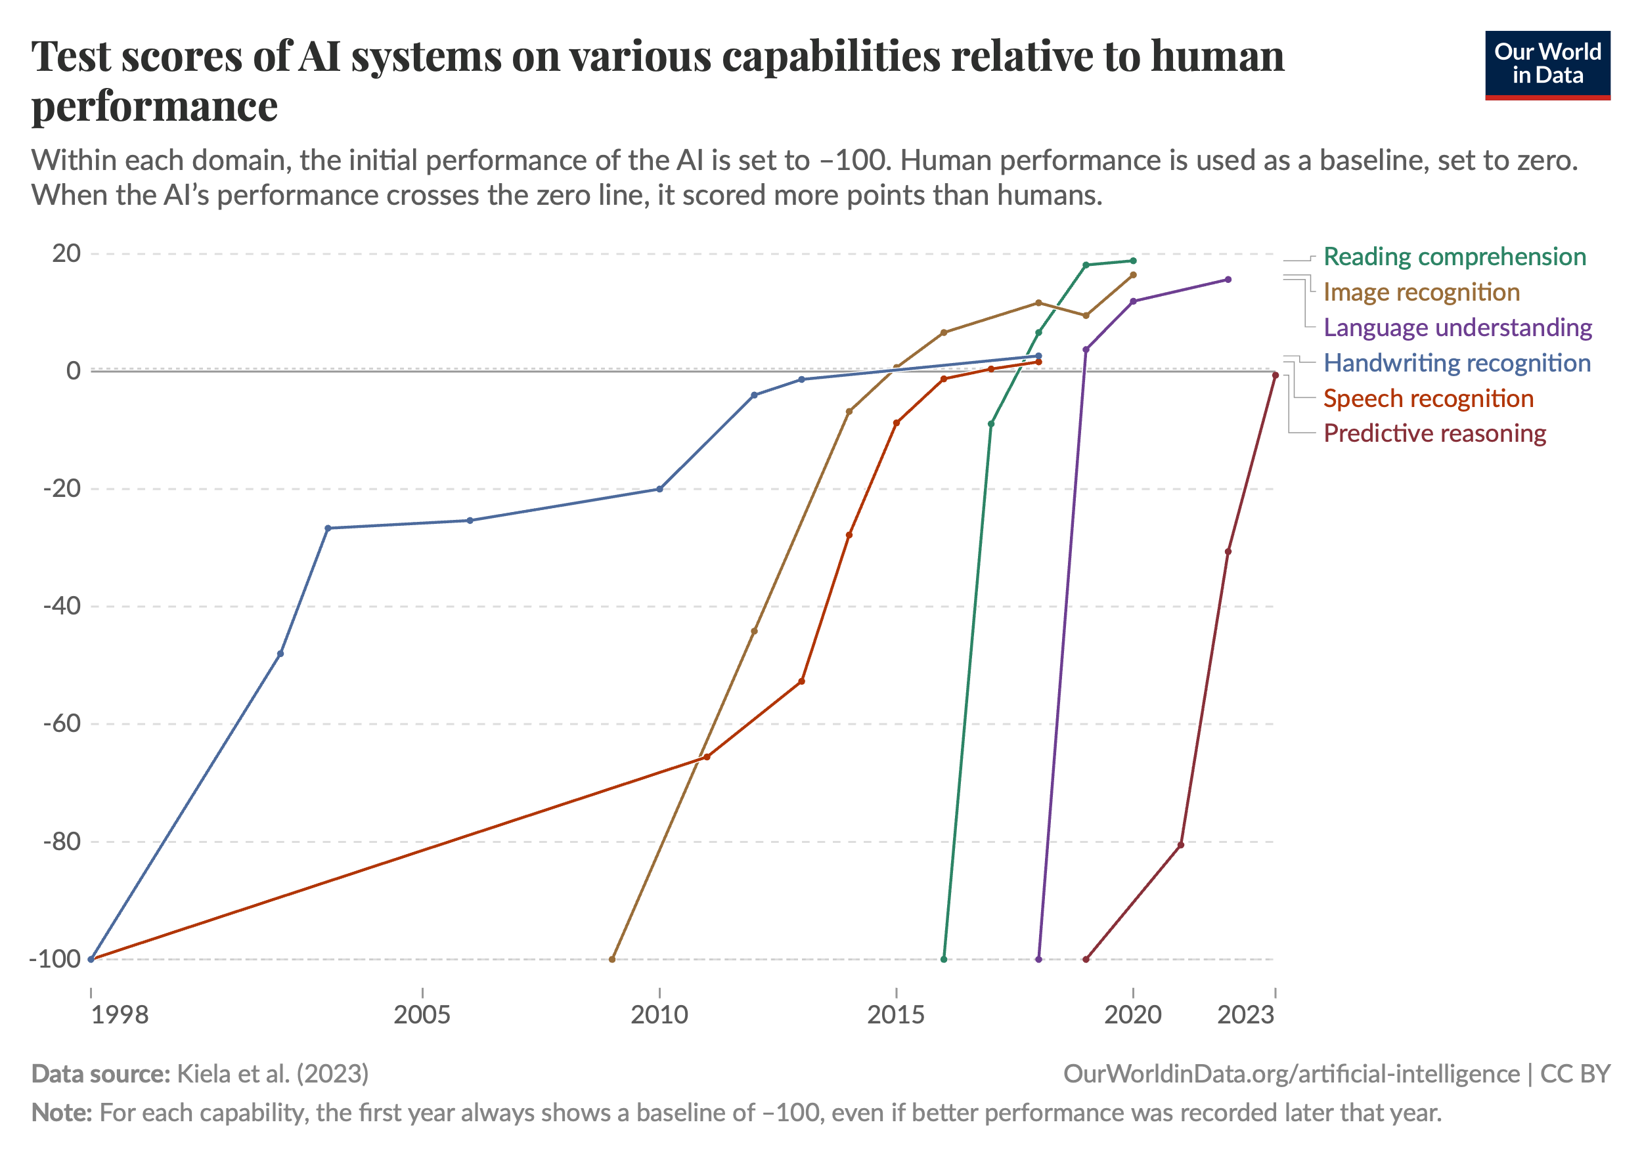
AI PERFORMANCE
Current frontier AI models significantly outperform humans on several domains.
Superhuman capabilities in reading comprehension, image recognition, language understanding, handwriting recognition, and speech recognition.
They also outperform experts on most exam-style problems at a fraction of the cost.
Yet the best AI agents still cannot independently carry out substantial projects or directly replace human labor.
Capabilities are increasing rapidly in some areas, but it remains unclear how this translates to real-world impact.
Source: Our World in Data
Notes:
AI is just getting started. Language models are great first generation technology, but still have very important shortcomings. Some of these are borne out by evaluation benchmarks, but the research community doesn’t even know how to evaluate many aspects of LLMs in the first place.
Important issues like hallucination, attribution and staleness are going to be solved in the not too distant future. Privacy will improve and the cost will go down.

Slide 25
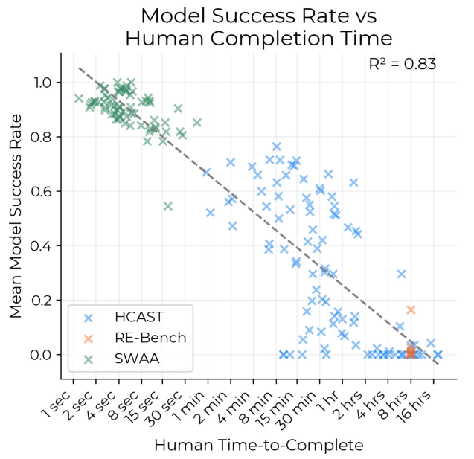
AI TASK LENGTH
Researchers found that the time taken by human experts is strongly predictive of model success on a given task.
AI agents struggle more with connecting long sequences of actions than with the skills or knowledge required to solve individual steps.
Current models achieve nearly a 100% success rate on tasks that take humans less than 4 minutes.
However, they succeed in less than 10% of tasks that take more than about 4 hours.
Source: Measuring AI Ability to Complete Long Tasks
Notes:
AI is just getting started. Language models are great first generation technology, but still have very important shortcomings. Some of these are borne out by evaluation benchmarks, but the research community doesn’t even know how to evaluate many aspects of LLMs in the first place.
Important issues like hallucination, attribution and staleness are going to be solved in the not too distant future. Privacy will improve and the cost will go down.

Slide 26
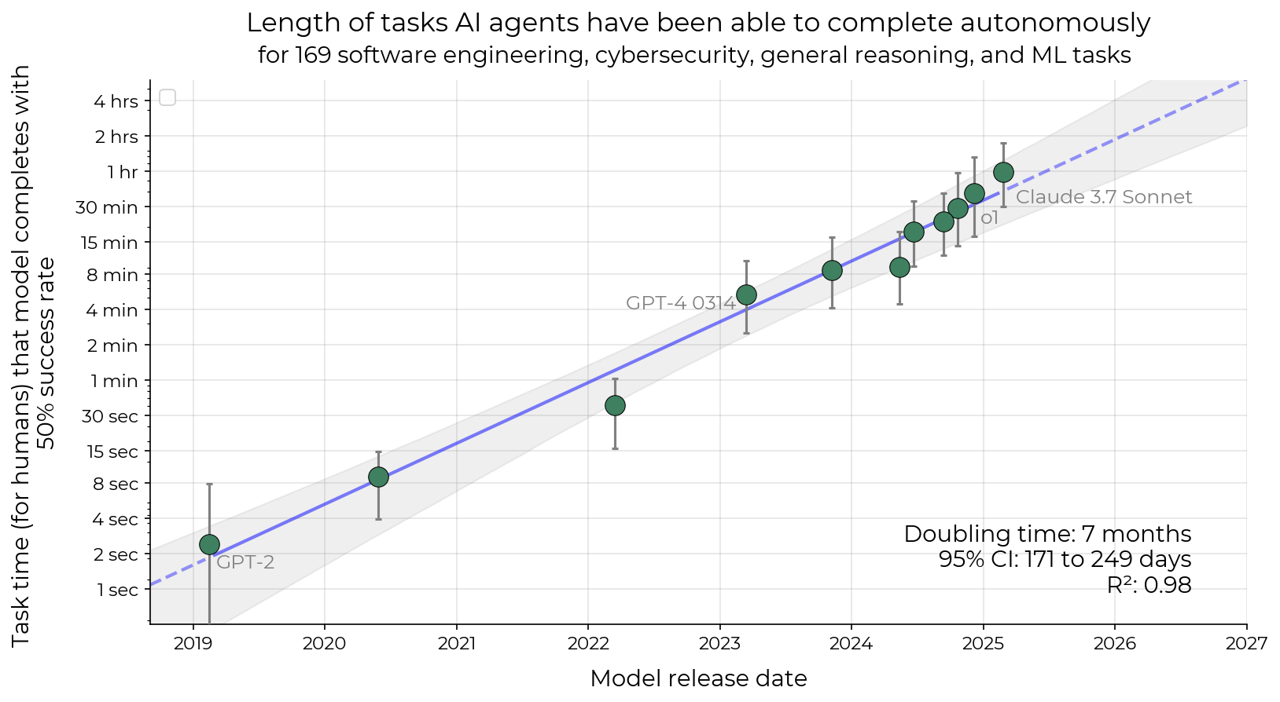
AI TASK IMPROVMENETS
The length of tasks Als can do is doubling every 7 months.
Source: Measuring AI Ability to Complete Long Tasks
Notes:
AI is just getting started. Language models are great first generation technology, but still have very important shortcomings. Some of these are borne out by evaluation benchmarks, but the research community doesn’t even know how to evaluate many aspects of LLMs in the first place.
Important issues like hallucination, attribution and staleness are going to be solved in the not too distant future. Privacy will improve and the cost will go down.

Slide 27
Agentic ai
Promise of Agentic AI:
Agentic AI is advancing rapidly and is on track to automate complex workflows that currently take hours of human effort.
These systems will adapt in real time to changing conditions and environments, making them more flexible and resilient than traditional automation tools.
They will make nuanced decisions in complex, open-ended scenarios where context and judgment are essential.
Reasons for Caution:
Agentic AI is not yet production-ready.
It still requires human oversight, making it unsuitable for full autonomy in enterprise settings.
Current systems may behave unpredictably in edge cases or unfamiliar environments.
Security and alignment concerns are still unresolved, especially in high-stakes or adversarial contexts.
Notes:
Agentic AI refers to AI systems that can autonomously perceive, reason, and act within a defined environment to pursue goals—often by coordinating tools, data, and interactions over time.
How It Works
Inputs
Accepts user prompts, system events, and messages from other agents.
Core Agent
LLM (Large Language Model): Core reasoning and language understanding.
Instructions: Goal-oriented task definitions.
Tools: External APIs or internal functions the agent can use (e.g., search, math, database access).
Tool Calls
Includes retrieval, action-taking, and memory to maintain continuity and context over time.
Outputs
Produces structured results or messages, and may trigger actions or collaborate with other agents.
Key Capabilities
Language understanding
Autonomy & decision-making
Adaptive learning & memory
Workflow orchestration
Multi-agent collaboration

Slide 28
Trends predict that in less than a decade we’ll see AI agents that can independently complete a large fraction of software tasks that currently take humans days or weeks.

Slide 29
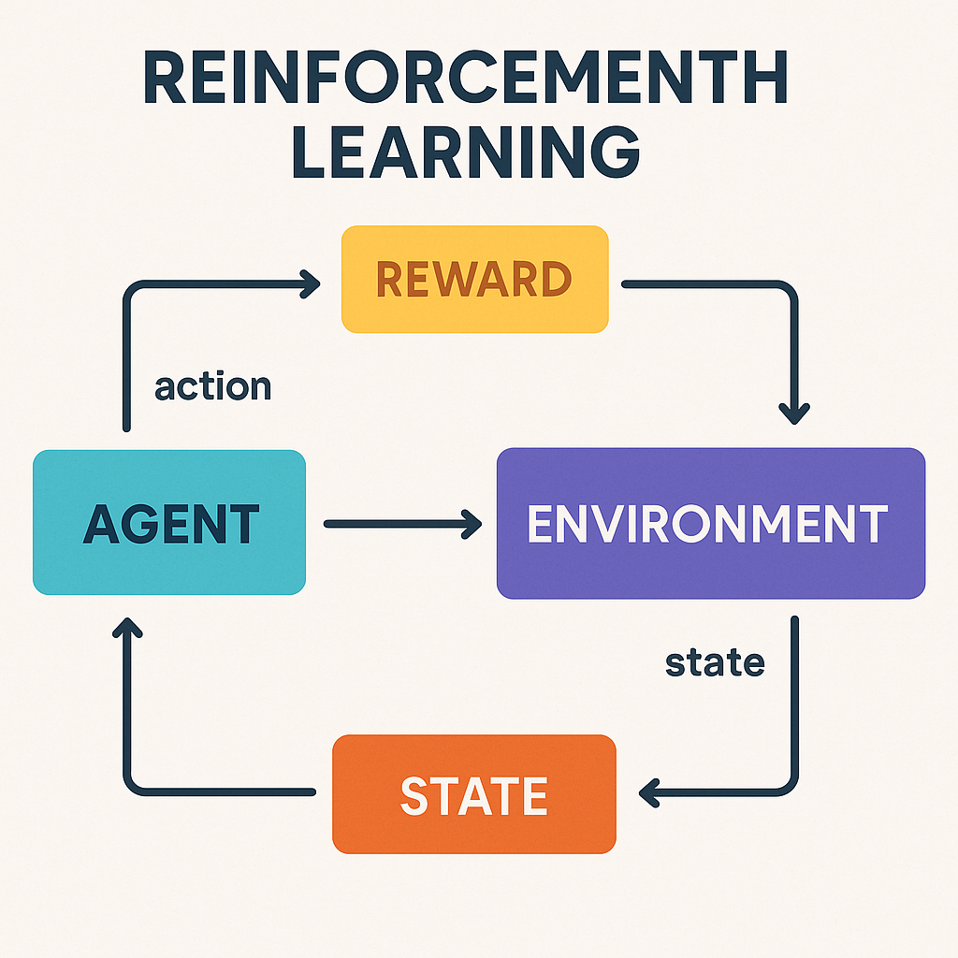
Reinforcement LEARNING
Reinforcement learning (RL) is a type of machine learning where an agent learns to make decisions by interacting with an environment and receiving rewards or penalties based on its actions.
It sits at the crossroads of computer science, engineering, mathematics, economics, psychology, and neuroscience.
It combines algorithms from machine learning, principles from control theory and operations research, and models of decision-making inspired by economic behavior and cognitive processes.
RL also reflects how humans and animals learn through rewards, drawing directly from psychological and neurological studies.
Source: Sora
Notes:
Reinforcement Learning is how an AI learns by trial and error, like training a dog or playing a video game.
An Agent (the AI) interacts with an Environment
It takes actions and gets rewards or penalties
Over time, it learns what actions lead to the best rewards
It’s like teaching an AI to make better choices by letting it experience success and failure.

Slide 30
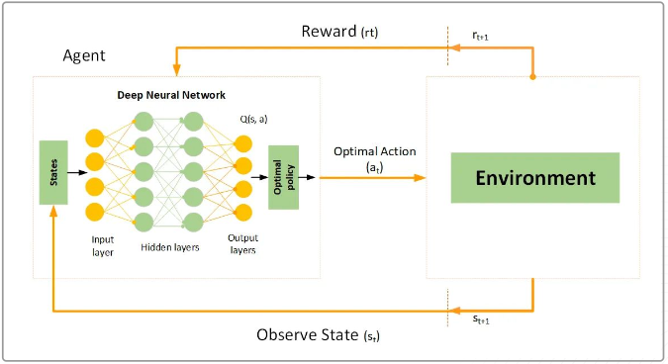
Reinforcement LEARNING
Learns through trial and error to maximize cumulative reward.
Receives sparse, delayed rewards or penalties from the environment.
No predefined dataset; data is generated through interaction with the environment.
Involves sequential decision-making where each action affects future states and rewards.
Must balance trying new actions (exploration) and using known strategies (exploitation).
Source: KungFU AI

Slide 31
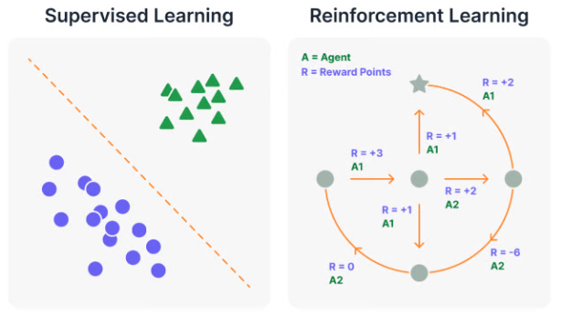
AI Reinforcement LEARNING
Researcher Andrej Karpathy has noted that there are two main learning paradigms in both children and AI:
Imitation Learning (supervised learning)
Trial-and-error learning (reinforcement learning)
He notes that almost all major deep learning breakthroughs have come from the second, reinforcement learning.
Example:
AlphaGo learned from human games (supervised learning) and then became superhuman through trial and error (RL).
RL creates emergent behaviors like planning, backtracking, and strategy.
These can’t be labeled by humans — they must be discovered. has noted that there are two main learning paradigms in both
Source: KungFU AI

Slide 32
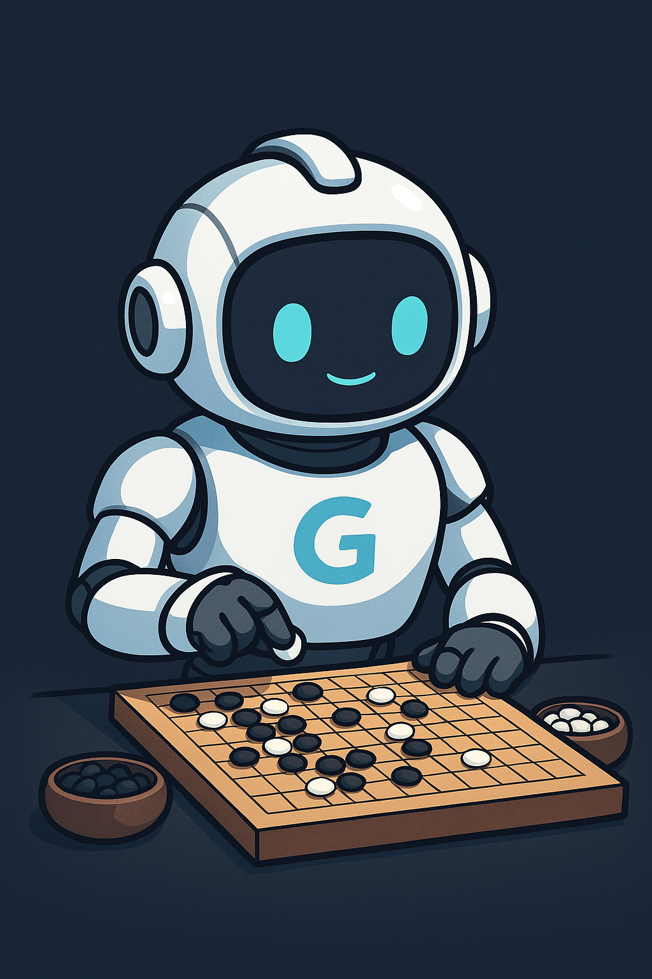
Reinforcement LEARNING: ALPHA GO
Google’s DeepMind stunned the AI world in 2016 with AlphaGo, a groundbreaking AI system that used reinforcement learning to master the game of Go.
Go was long considered too complex for computers due to its vast search space (it has vastly more possible game states than chess).
In its second game against world champion Lee Sedol, AlphaGo made a move that shocked experts: “Move 37.”
It placed a stone on an unconventional part of the board, breaking established Go patterns. Human experts initially thought it was a mistake.
Later, it was recognized as brilliant and strategically sound, shifting the game’s momentum.
It has since changed the game of Go by pushing the boundaries of human intuition and entered the corpus that students of Go will study forevermore.
Source: Sora
Notes:
Go in more than 2500 years old, and AI flipped the script on how to play just a few years ago.

Slide 33
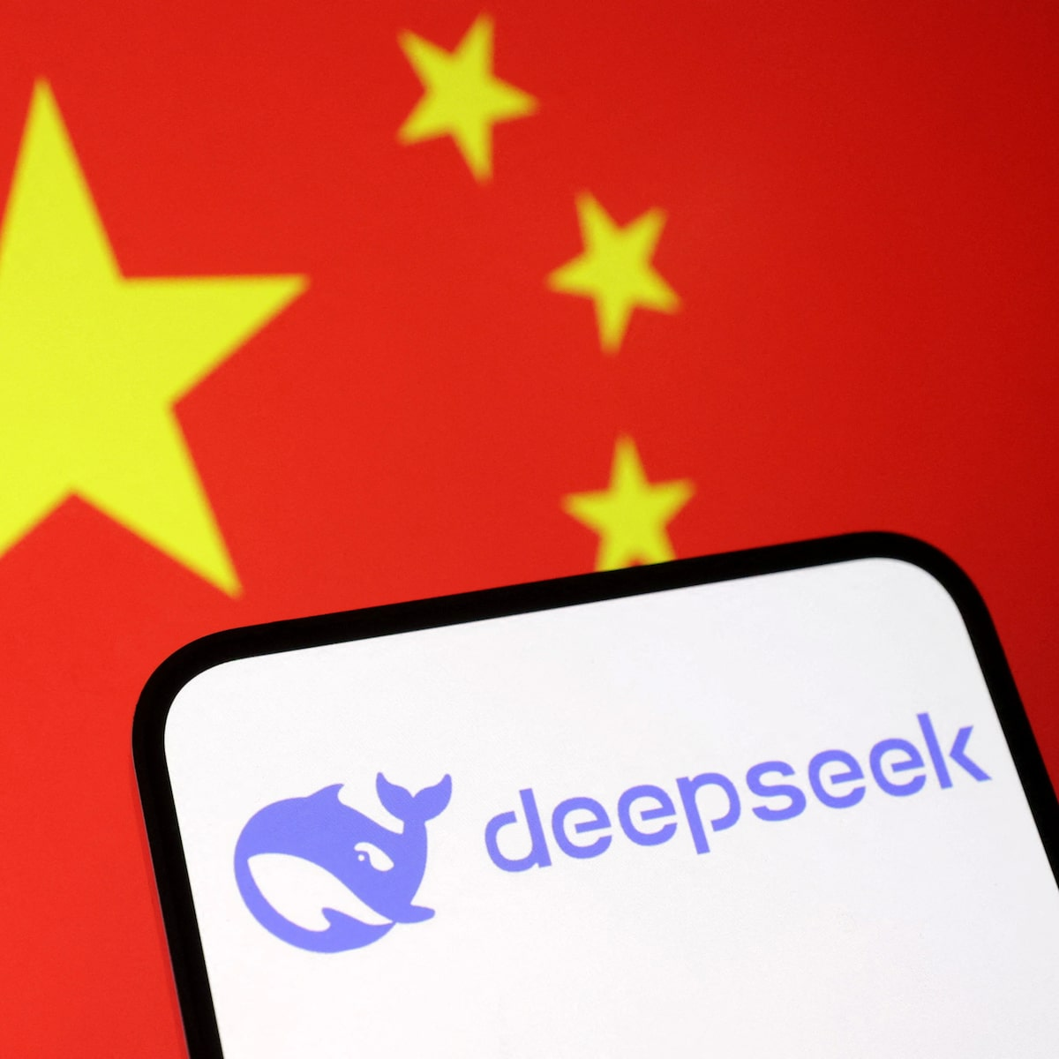
AI REASONING MODELS
DeepSeek, a Chinese AI laboratory, released R1 in January 2025, a frontier reasoning model.
Reasoning models are a type of AI system, typically a large language model (LLM), that’s optimized to solve problems requiring multi-step thinking, logic, deduction, or structured analysis, rather than just retrieving or rephrasing information.
R1 is a flagship reasoning models with very impressive benchmark metrics on par with OpenAI’s o1 reasoning model, but at a fraction of the cost.
Released under an MIT license that allows companies and researchers to build upon and train on its outputs (synthetic data).
The news shocked investors and caused NVIDIA stock to drop 17%, erasing nearly $600 billion in market value.
Source: Reuters
Notes:
DeepSeek R1 was trained using reinforcement learning (RL) to develop reasoning-driven self-correction. During training, it was rewarded not just for correct answers, but for iterative improvement, learning to:
Reflect on initial outputs
Detect flaws or gaps in logic
Rerun reasoning steps to improve results
This process, reinforced across diverse tasks, taught the model to critique its own outputs and revise answers autonomously, mirroring human-like reasoning loops.

Slide 34
AI REASONING MODELS
DeepSeek R1 was trained in four phases, each designed to progressively scale model capabilities.
Notes:
DeepSeek R1 was trained through a structured four-phase reinforcement learning (RL) process, each stage adding specialized capabilities to the model:
Stage 1: Cold Start Fine-Tuning
Begins with a Base RL-Zero Model, which has no prior task-specific knowledge
Fine-tuning calibrates this foundation using supervised signals or basic objectives to prepare for RL-based training.
Stage 2: Reasoning RL
Focus shifts to enhancing the model’s logical reasoning and decision-making through targeted RL objectives.
Reinforcement Learning is used to teach the model to improve over iterative problem-solving scenarios.
Stage 3: Thinking Mode Fusion
Multiple thinking strategies (e.g., chain-of-thought, step-by-step reasoning) are integrated into a unified framework.
This helps the model blend different inference styles for better versatility and consistency.
Stage 4: Mixed General RL
Final stage combines tasks and learning environments in a generalized multi-domain RL setup.
Trains the model to perform well across a wide variety of prompts and instructions, simulating real-world use.
The result is the DeepSeek R1 Model, capable of strong reasoning, generalization, and adaptive thinking.

Slide 35
AGI Within SIGHT
In the last few months, it’s become clear that Artificial General Intelligence (AGI) is near.
Intelligence unfolds on a spectrum:
Ants may not “think”, but dogs certainly seem to.
However, it's unlikely that dogs are capable of metacognition (thinking about thinking).
The ability to reflect on our own thoughts, recognize our misconceptions, and learn from them appears to be unique to humans.
Once you can think about thinking, you unlock a recursive process that is limitless. We can think about thinking about thinking, ad infinitum.
R1 shows that given a sufficiently large and well pre-trained base model, using cold start chain-of-thought training and pure RL on verifiable domains (e.g. math and coding) is sufficient to elicit emergent reasoning abilities.
This marks a turning point.
For the first time, we have a clear, documented path to training reasoning models at scale.
The implications are profound.
If reasoning ability can be systematically unlocked through reinforcement learning, then AGI is no longer a distant theoretical milestone, it’s an engineering challenge.
Notes:
DeepSeek R1 was trained using reinforcement learning (RL) to develop reasoning-driven self-correction. During training, it was rewarded not just for correct answers, but for iterative improvement, learning to:
Reflect on initial outputs
Detect flaws or gaps in logic
Rerun reasoning steps to improve results
This process, reinforced across diverse tasks, taught the model to critique its own outputs and revise answers autonomously, mirroring human-like reasoning loops.

Slide 36
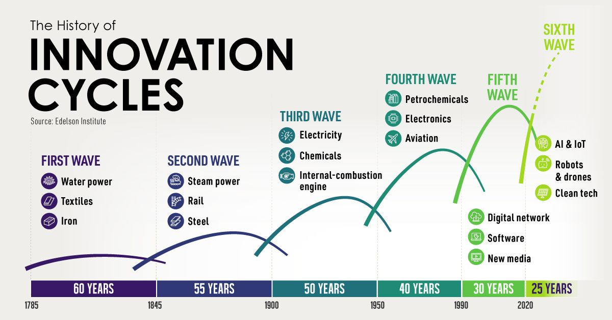
We’re in the sixth wave of innovation
Notes:
We’re in the sixth wave of innovation, and each subsequent wave approaches faster and faster – and AI, specifically AGI and ASI will increase the speeds exponentially.

Slide 37
AI ADOPTION
of organizations believe AI will give them a competitive edge
87%
Source: MIT Sloan Management Review
Notes:
Transforming data for powerful AI solutions reduces the time and effort to unlock value from your data. Plus, these models are designed to address the specific business problems at hand and provide meaningful insights that drive informed decision-making.
Strategically unify your data to leverage AI
93% of respondents agree that data strategy is critical to getting value from generative AI. AI initiatives are only as good as the data they’re built on, so a strong data foundation and strategy is critical for successful AI innovation. By moving to a single foundation that’s built on a lake-based architecture, you can do everything from data preparation to modeling to quickly discovering insights, all directly from your lakehouse.
Accelerate data scientists’ productivity
When it comes to productivity, business users and data professionals should be equipped with the tools and capabilities to streamline and automate processes, freeing up their time for more impactful work. Forrester reported that “business, technology, and marketing leaders’ investment in genAI in the year ahead will augment employees’ creative problem-solving time by up to 50% — driving customer-centric innovation and creating greater business value.”
Achieve cost and performance efficiencies
By increasing productivity across the business, you’re able to make the most of your data investments with a solution that drives performance efficiencies across your organization. 57% of leaders believe AI and ML will play a significant role in achieving business objectives over the next three years – leveraging artificial intelligence and machine learning models that eliminate errors and automate processes, your teams will be able to discover new revenue opportunities while saving time and money.

Slide 38
AI-FUELeD BUSINESS GROWTH
93%
50%
57%
of respondents agree that data strategy is critical to getting value from generative AI¹
improvement of employees’ creative problem-solving time due to investments in generative AI²
of leaders believe that AI and ML will be important in achieving business objectives over the next three years³
Sources: ¹GMIT, ²Forrester, ³KPMG
Notes:
Transforming data for powerful AI solutions reduces the time and effort to unlock value from your data. Plus, these models are designed to address the specific business problems at hand and provide meaningful insights that drive informed decision-making.
Strategically unify your data to leverage AI
93% of respondents agree that data strategy is critical to getting value from generative AI. AI initiatives are only as good as the data they’re built on, so a strong data foundation and strategy is critical for successful AI innovation. By moving to a single foundation that’s built on a lake-based architecture, you can do everything from data preparation to modeling to quickly discovering insights, all directly from your lakehouse.
Accelerate data scientists’ productivity
When it comes to productivity, business users and data professionals should be equipped with the tools and capabilities to streamline and automate processes, freeing up their time for more impactful work. Forrester reported that “business, technology, and marketing leaders’ investment in genAI in the year ahead will augment employees’ creative problem-solving time by up to 50% — driving customer-centric innovation and creating greater business value.”
Achieve cost and performance efficiencies
By increasing productivity across the business, you’re able to make the most of your data investments with a solution that drives performance efficiencies across your organization. 57% of leaders believe AI and ML will play a significant role in achieving business objectives over the next three years – leveraging artificial intelligence and machine learning models that eliminate errors and automate processes, your teams will be able to discover new revenue opportunities while saving time and money.

Slide 39
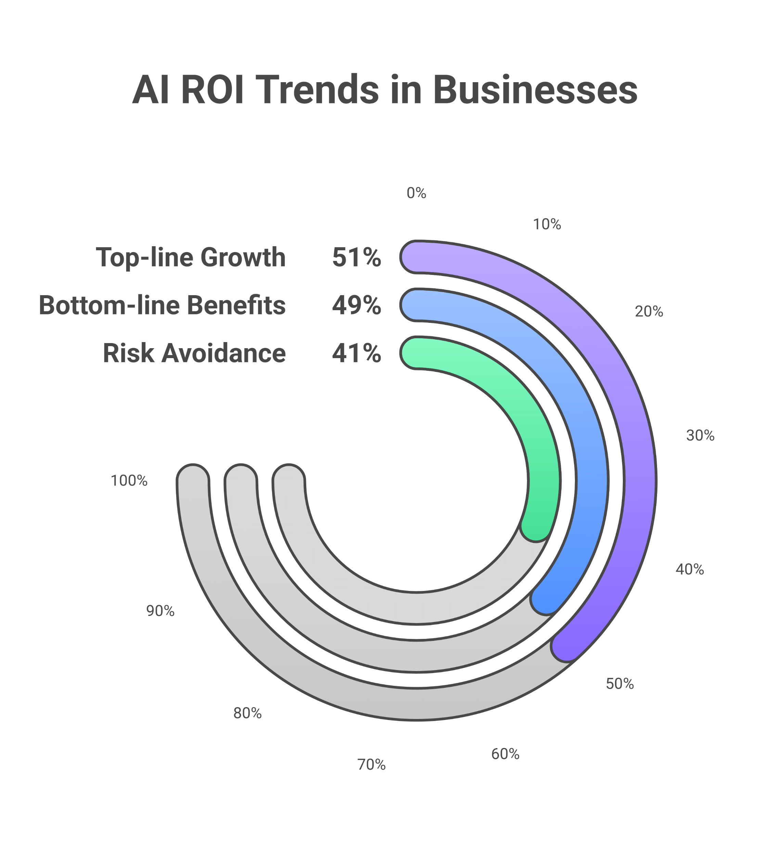
AI ROI
51%
Of businesses report top-line growth through AI (e.g., revenue and customer acquisition).
49%
Observe bottom-line benefits (e.g., cost reduction and efficiency).
41%
Achieve risk avoidance (e.g., compliance, predictive maintenance).
Sources: ¹Gartner,²Forrester
Notes:
Realizing ROI in AI Investments
Positive ROI Trends:
51% of businesses report top-line growth through AI (e.g., revenue and customer acquisition).
49% observe bottom-line benefits (e.g., cost reduction and efficiency).
41% achieve risk avoidance (e.g., compliance, predictive maintenance).
Key Drivers for ROI:
Strategic Alignment: Link AI initiatives with core business objectives.
Categorization of Investments:
Commoditized: Automation tools.
Enabling: Enhances operational efficiency.
Differentiating: Provides competitive advantage.
Iterative Funding Models: Pilot solutions to validate value before scaling.
Challenges:
High initial costs and complexity.
Cost-value alignment critical for sustainable ROI.
Resources:
Forrester’s State of AI Survey 2024: Insights on generative AI ROI trends.
Forrester Website
Gartner’s Hype Cycle for AI 2024: Challenges and sustainability insights.
Gartner Website
Industry case studies on AI ROI:
Retail: Personalized marketing boosting sales.
Healthcare: Generative AI reducing documentation time.
Manufacturing: AI-driven maintenance minimizing downtime.
Takeaway:
Investing in AI projects yields substantial returns when strategically planned, measured, and optimized.

Slide 40
The Rise of AI and Data CenterS
Since 2016, U.S. data center energy usage has nearly tripled—from 60 to 176 TWh in 2023.
Source: 2024 United States Data Center Energy Usage Report
RAPID
Growth
Energy Consumption
AI / GPU
SERVERS
Of AI-driven data center energy usage.
Rose from ~60 TWh (2016) to 176 TWh (2023) in the U.S.
Significantly contributing since 2017.
Notes:
Since 2016, U.S. data center energy usage has nearly tripled—from 60 to 176 TWh in 2023. This surge is tied directly to AI workloads, particularly GPU-accelerated servers, which now dominate power demand across cloud and enterprise systems.

Slide 41
THE IMPORTANCE OF TSMC
Why TSMC Matters
Chipmaking Powerhouse: TSMC produces more than 90% of the world’s most advanced AI chips (3nm and below).
Supplies AI Leaders: Key chip supplier for Nvidia, Apple, AMD, and even OpenAI’s hardware partners.
Enabling AI Scale: Advanced GPUs and TPUs used for AI training are impossible without TSMC’s leading-edge fabs.
Strategic Role in AI’s Future
Bottleneck or Accelerator: The pace of AI advancement hinges on chip availability, TSMC controls the pipeline.
National Security Asset: Taiwan’s chip dominance has become a geopolitical flashpoint in US–China tech competition.
Innovation Engine: TSMC drives the frontier of chip miniaturization, efficiency, and production scale—directly influencing how fast and far AI can grow.
Notes:
Without TSMC’s fabs, the AI revolution would stall. With them, it accelerates.
TSMC's New Mexico Facility: Strategic Importance
Why It Matters for AI and National Security
Boosts U.S. Chip Independence Reduces reliance on Taiwan for advanced semiconductors—crucial for AI, defense, and critical infrastructure.
Enables Domestic AI Growth Supports the supply of high-performance chips for U.S.-based AI startups, cloud providers, and defense contractors.
Enhances Supply Chain Resilience Helps diversify global chip production amid rising geopolitical tensions, especially in the Taiwan Strait.
Accelerates AI Hardware Access Cuts down logistics and manufacturing time for U.S.-based AI developers relying on GPUs and ASICs.
Strengthens Economic & Tech Leadership Aligns with U.S. CHIPS Act goals to re-shore key parts of the semiconductor supply chain and maintain AI competitiveness.

Slide 42
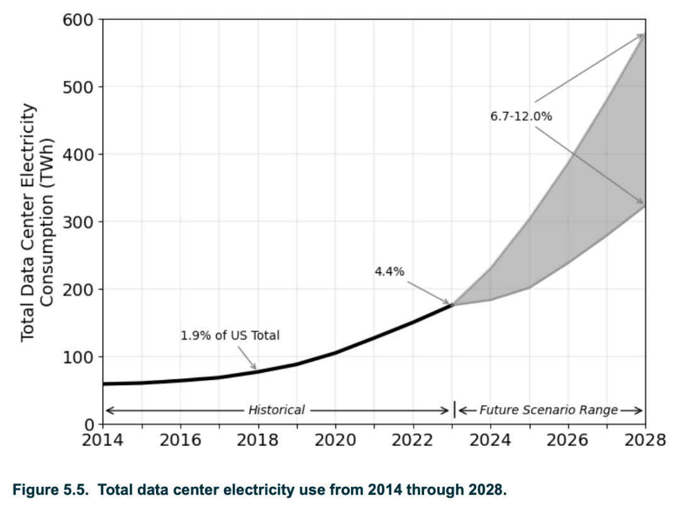
AI Driving Power Demand – Current Trends
AI servers aren’t just more powerful—they’re far more power-hungry.
AI workloads require specialized, GPU-intensive servers.
Significant operational power increases (multiple kW per server)
U.S. data center energy projected to reach 325–580 TWh by 2028.
Source: 2024 United States Data Center Energy Usage Report
Notes:
AI servers aren’t just more powerful—they’re far more power-hungry. A single 8-GPU AI server can draw over 5 kW on average. As adoption scales, U.S. energy use is forecast to reach up to 580 TWh by 2028—12% of national electricity use

Slide 43
NATIONAL SECURITY IMPLICATIONS
THE AI RACE WITH CHINA
AI CAPABILITIES
DATA CENTERS
STRATEGIC Imperative
Increased AI capability is essential for maintaining technological supremacy.
Increased dependency on data centers (including energy and power) elevates vulnerabilities.
There is a strategic imperative to maintain AI infrastructure leadership.
Notes:
AI superiority equals national superiority. The race with China is not just about models—it's about infrastructure. Whoever controls the data and compute layer wins. That means building secure, resilient, and energy-abundant AI ecosystems here at home

Slide 44
AI’S IMPACT ON JOBS
IT IS TOUGH TO ESTIMATE AI’S TRUE IMPACT ON JOBS, AS WE’RE STILL IN THE EARLY DAYS OF ADOPTION.
The transportation and manufacturing sectors will likely be the most affected.
ONE THING IS CLEAR, LIKE DURING TECHNOLOGICAL REVOLUTIONS OF THE PAST, JOBS WILL BE LOST.
The transportation sECTOR ACCOUNTS FOR 25% of THE US ECONOMY, and WAYMO, TESLA, and Aurora are coming.
LIKE WITH PREVIOUS TECHNOLOGICAL ADVANCEMENTS, NEW JOBS WILL ALSO BE CREATED.
With the time freed up from automation and ai, business leaders will have more time to plan big picture.
Notes:
This disparity weakens NATO. Joint operations rely on shared digital capabilities. A tech-gap risks allied interoperability and increases dependency on U.S. platforms—undermining our collective resilience against cyber and AI-enabled threats.

Slide 45
Energy Demand and Strategic Competition
CHINA is scaling AI infrastructure aggressively using everything from SOLAR to COAL.
China's rapid expansion of data center infrastructure.
Critical to recognize AI infrastructure as national security priority.
Strategic investment in secure, sustainable energy for U.S. leadership.
Notes:
China is scaling AI infrastructure aggressively using everything from solar to coal. The U.S. needs a strategic response. We must treat AI power demand like we treat critical defense capabilities—backed by policy, resources, and federal coordination.

Slide 46
NATO Allies
Falling Behind
SLOW European investment in data center and AI infrastructure.
Conservative GPU adoption, slower refresh cycles hinder competitiveness.
European regulatory focus slowing practical AI deployment.
Notes:
Europe, in contrast, is dragging. GPU adoption is slow. Investment in hyperscale infrastructure is inconsistent. While the U.S. and China scale AI, some NATO allies are still stuck in regulatory paralysis—creating strategic imbalances in the alliance.

Slide 47
AI INVESTMENT BY COUNTRY (2013-2024)
United States
$470.9 Billion
2.4%
4.3%
CHINA
18.4%
$119.3 Billion
72.6%
2.3%
United Kingdom
$28.2 Billion
Canada
$15.3 Billion
ISRAEL
$15.0 Billion
Source: Stanford
Notes:
As of 2025, the top five countries by total private AI investment from 2013 to 2024 are:
United States – $470.9 billion The U.S. leads by a significant margin, with investments exceeding the combined total of all other countries. This dominance is driven by major tech companies like OpenAI, Google, Microsoft, and Nvidia, as well as a robust venture capital ecosystem.
China – $119.3 billion China maintains a strong position with substantial investments in AI, particularly in sectors like surveillance, fintech, and manufacturing automation.
United Kingdom – $28.2 billion The UK leads in Europe for AI funding, supported by government-backed initiatives and a strong start-up ecosystem.
Canada – $15.3 billion Canada has built a solid reputation for AI research and innovation, particularly in natural language processing and deep learning.
Israel – $15.0 billion Israel's strong AI infrastructure and its status as a center for AI innovation contribute to its significant investment figures.

Slide 48
Consequences of Lagging Allies
Increased European reliance on U.S. digital and energy resources.
Challenges to interoperability and collective security posture.
Reduced NATO resilience to cyber threats and adversaries.
Notes:
This disparity weakens NATO. Joint operations rely on shared digital capabilities. A tech-gap risks allied interoperability and increases dependency on U.S. platforms—undermining our collective resilience against cyber and AI-enabled threats.

Slide 49
CHINA’S APPROACH?
ALL OF THE ABOVE
China aggressively addressing energy demand, prioritizing AI leadership.
Rapid construction of data centers powered by coal alongside renewables and nuclear.
Raises global environmental concerns and geopolitical pressures on sustainability goals.
Notes:
Europe, in contrast, is dragging. GPU adoption is slow. Investment in hyperscale infrastructure is inconsistent. While the U.S. and China scale AI, some NATO allies are still stuck in regulatory paralysis—creating strategic imbalances in the alliance.

Slide 50
Bridging Energy Demand –Natural Gas and Nuclear
Natural Gas
NUCLEAR
South Dakota planning data centers powered by natural gas, serving as stable, scalable power source.
Texas announced plans for new nuclear reactors, providing carbon-free, reliable, large-scale power.
Notes:
AI superiority equals national superiority. The race with China is not just about models—it's about infrastructure. Whoever controls the data and compute layer wins. That means building secure, resilient, and energy-abundant AI ecosystems here at home

Slide 51
Policy Implications and RECOMMENDATIONS
Promote joint transatlantic energy & tech infrastructure projects.
Strategic incentives for Europe to accelerate AI/data center infrastructure.
Encourage AI standardization & interoperability within NATO.
AI Superiority
Notes:
To compete, we need coordinated energy and AI investment across the Atlantic. That includes AI governance standards for NATO, incentives for European infrastructure, and U.S.-led efforts to build a secure, scalable, tech-forward energy grid.

Slide 52
Future Scenarios and STRATEGIC PLANNING
Projected scenarios for AI-driven energy demand (optimistic vs. pessimistic).
Research
Importance of strategic, long-term planning for sustainable AI operations.
Planning
Opportunity to use energy infrastructure build-out to lead globally.
Strategy
VICTORY
Notes:
Best case? Smart policies, global coordination, and clean energy help meet demand. Worst case? Infrastructure bottlenecks limit AI progress—and we fall behind. 2025–2028 is the window to act before energy demand outpaces strategic readiness.

Slide 53
THANK YOU! QUESTIONS?

